Slide 1



Communicating Requirements in Software Engineering
Nicholas Gardella,
HFES at UVA,
Riggs Lab

Slide 2

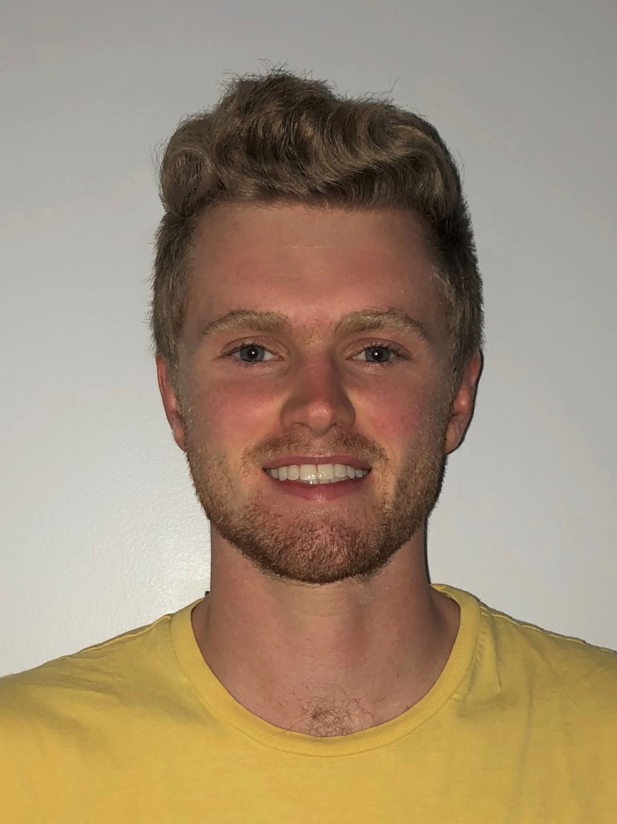


Bio
BS, Computer Science, Virginia Tech, 2021
(soon to be) ME, Systems Engineering, UVA, 2023
PhD Student, Systems Engineering, UVA
Member, Riggs Lab (sriggslab.com)
NSF Cyber-Physical Systems Research Trainee
Certified Scrum Product Owner, Leidos, 2021
Webmaster, Human Factors & Ergonomics Society @ UVA (hfes.atuva.ga)

Slide 3
What is engineering?

Slide 4
What is software engineering?

Slide 5
What is systems engineering?

Slide 6
Is it Operating Systems?
for (i = 0; i < NUM_THREADS; i++) {
printf("IN MAIN: Creating thread %d.\n", i);
thread_args[i] = i;
result_code = pthread_create(&threads[i], NULL, perform_work, &thread_args[i]);
assert(!result_code);
}

Slide 7
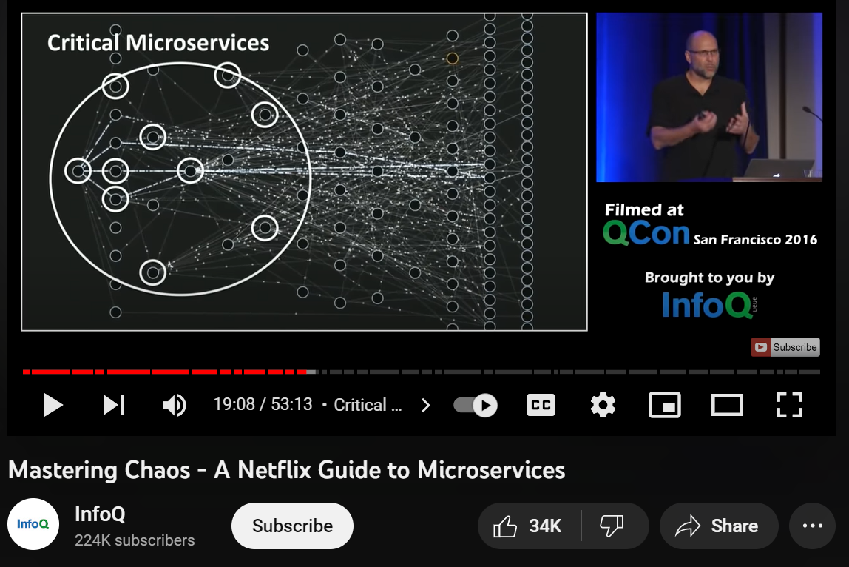
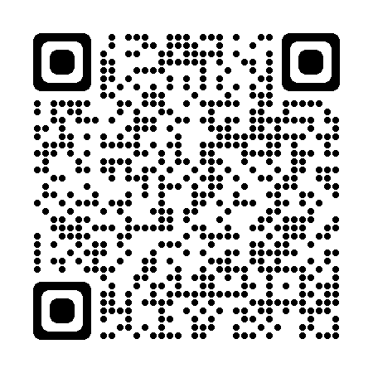
Is it Networking Systems?
Great Video

Slide 8
systems engineering is information engineering

Slide 9
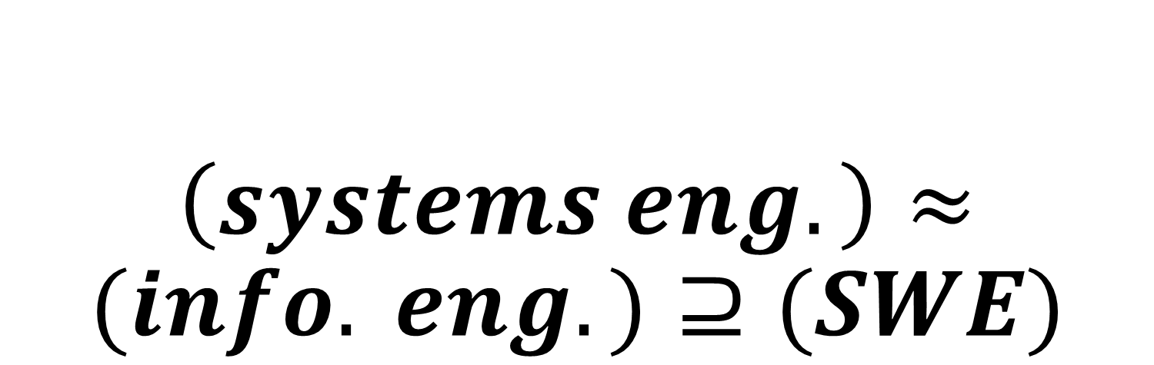
$\left(systems eng.\right)≈(info. eng.)⊇(SWE)$

Slide 10
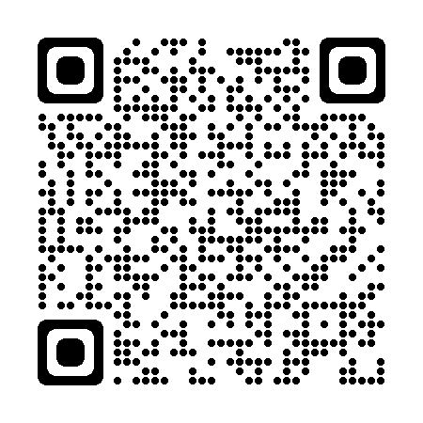

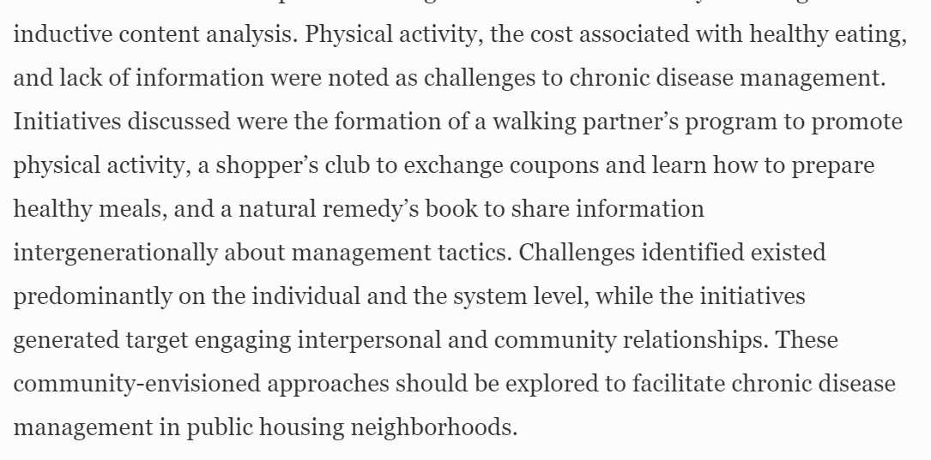
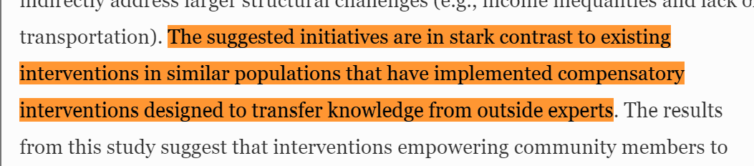











It is information engineering.

Slide 11


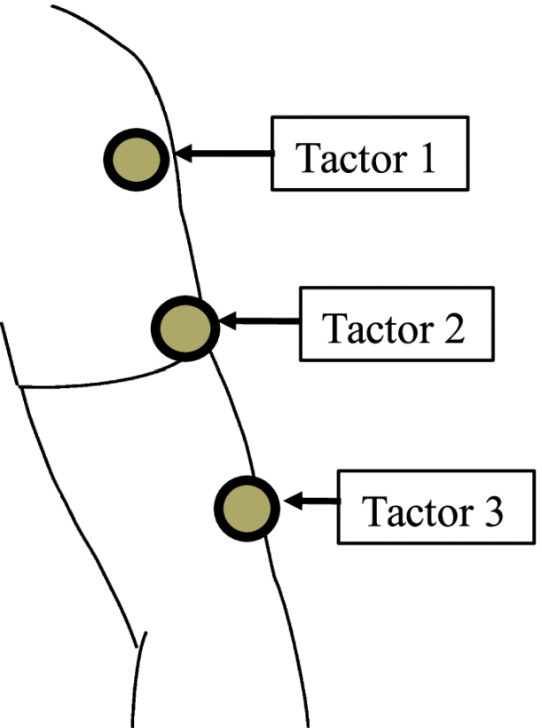

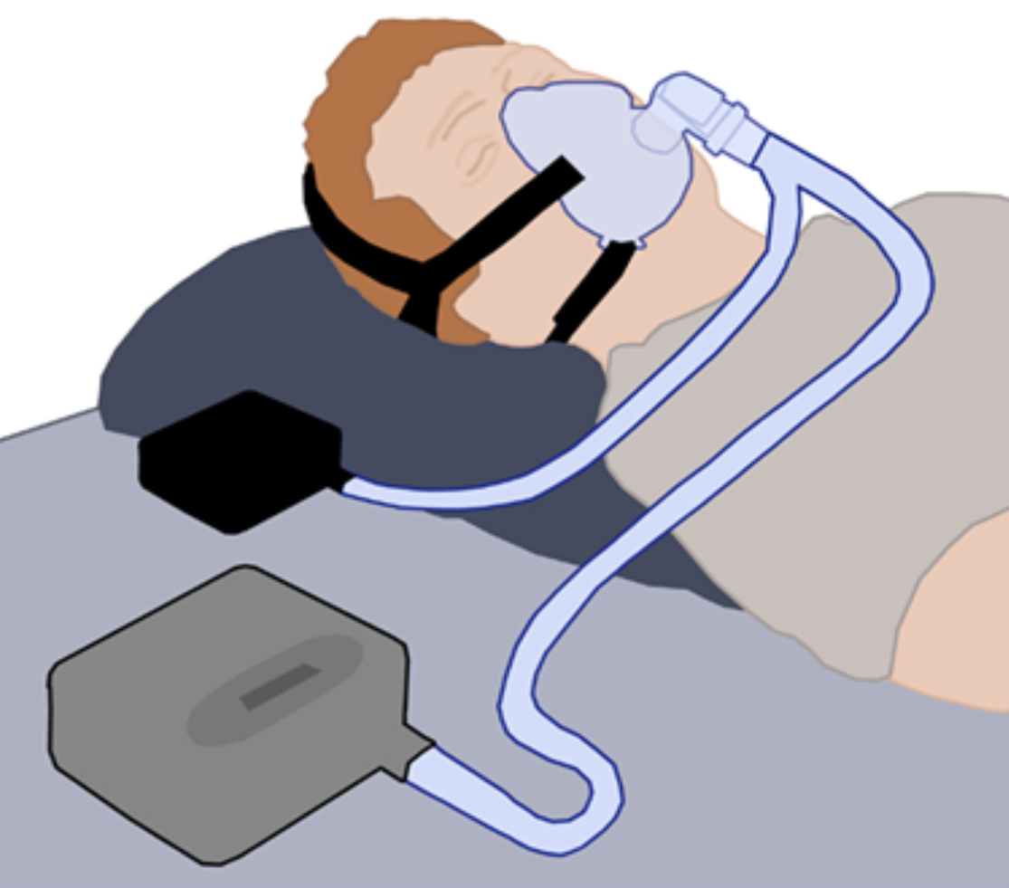
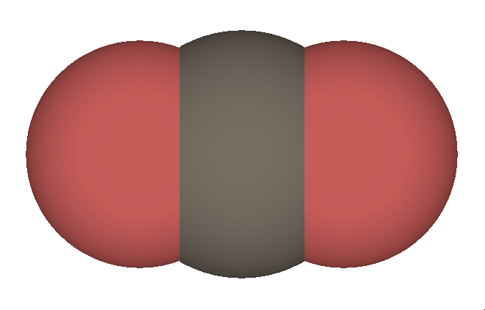
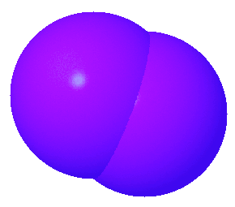

It is information engineering.
Pressure
How can continuous data be naturally encoded in tactile pulses?
Speed
Tactile Pulses
Mental Mapping
Intensity
Pulse Duration
Spacing (ISI)
Motion (SOA)
???
Size/Volume
[1]
Concentration
[1] K. M. Gomes, S. T. Reeves, and S. L. Riggs
[2] Creative commons license images
CO2
O2

Slide 12





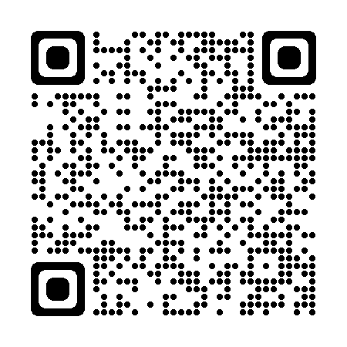
It is information engineering.
Interested? Get involved
Human
AI
Task
IDE
2 X (
+
+
+
)
Human
Task
IDE
2 X (
)
+
+
njg4ne@virginia.edu

Slide 13
It is information engineering.
Interested? Get involved
Context
AIDE Trust
Self-Confidence
Workload
Affect
Stress
Team Performance
Rationality
Adaptability
njg4ne@virginia.edu

Slide 14

Universals
Goals
Metrics
Tradeoffs
(what to do)
(assessing success)
(what matters most)

Slide 15
Is it just common sense?

Slide 16
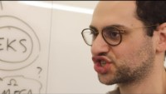

Why systems engineering?
Funny Video

Slide 17
Example: running a 5k
Goals
Metrics
Tradeoffs

Slide 18
Example: personal project
Goals
Metrics
Tradeoffs

Slide 19
How do you communicate this to a developer?

Slide 20
Game: explain in plain english

Slide 21
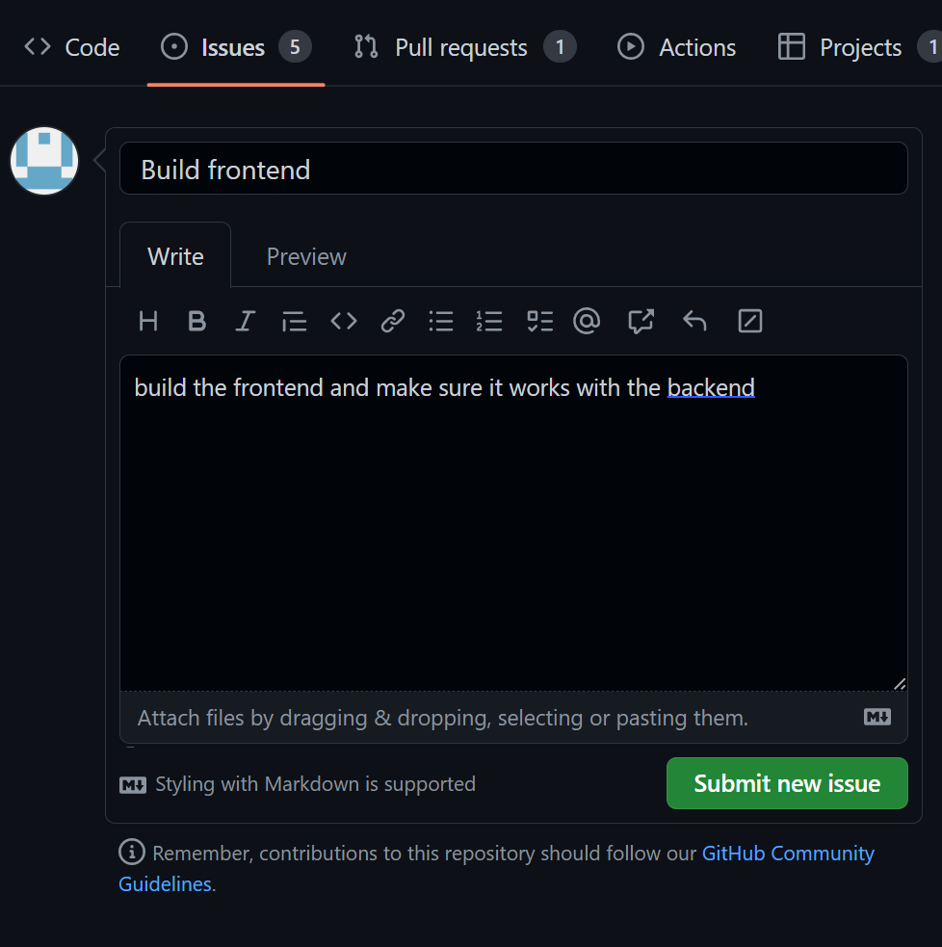
How’s this?

Slide 22
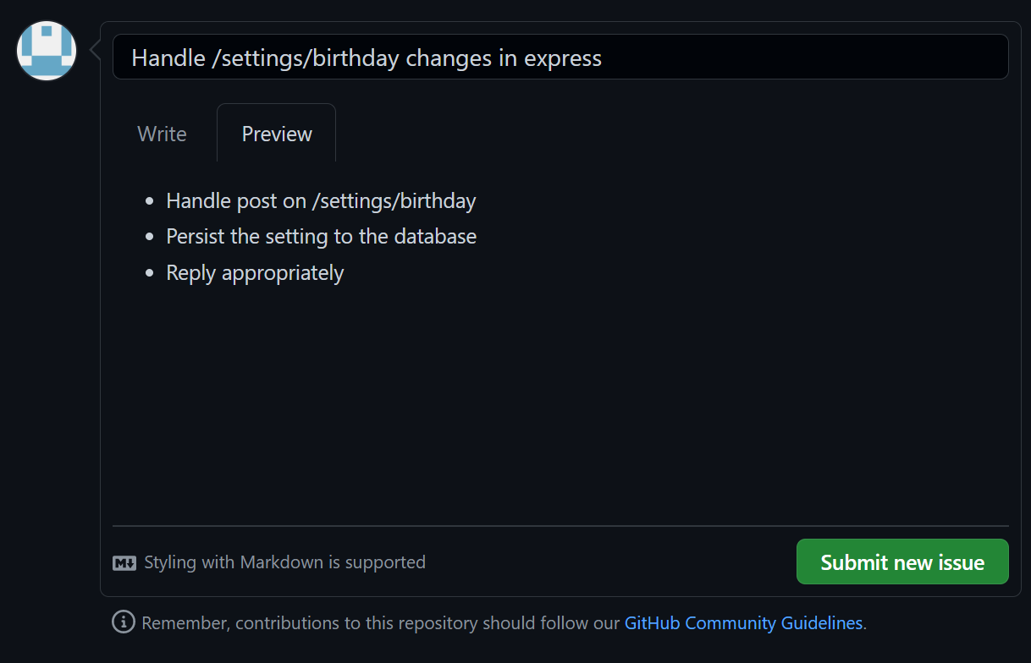
How’s this?

Slide 23
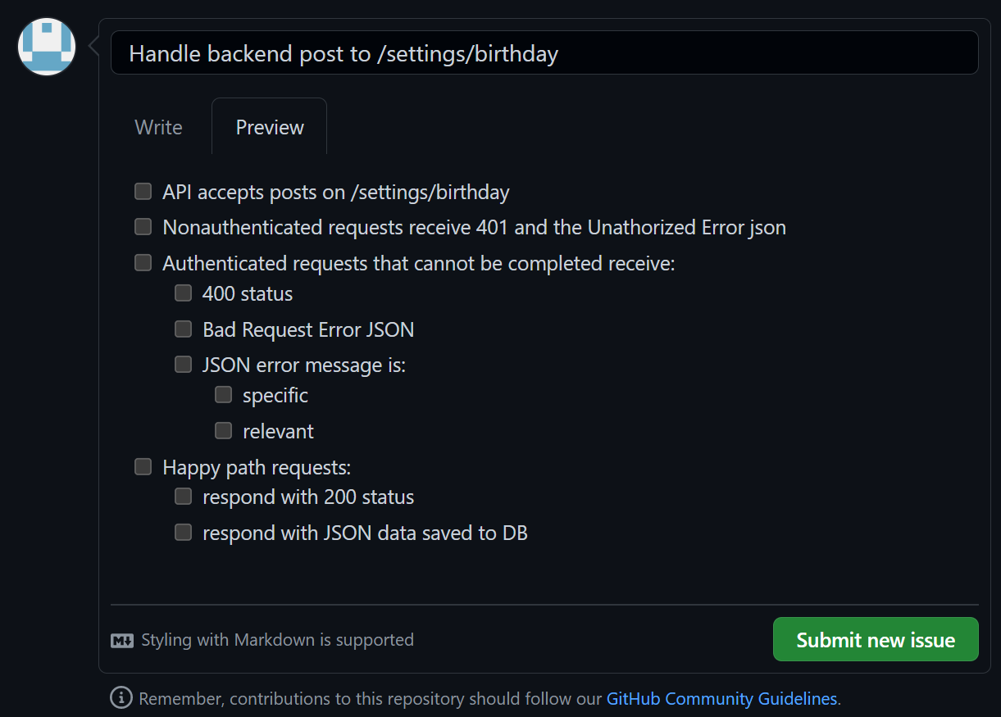
How’s this?

Slide 24
Who checks the checkboxes?

Slide 25
Is it worth it?

Slide 26
More & better information is powerful.

Slide 27
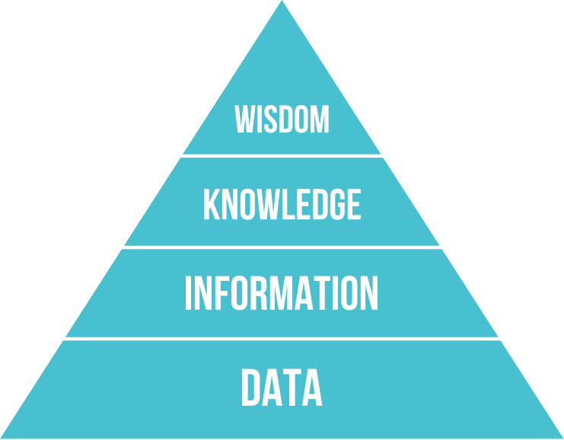

Slide 28
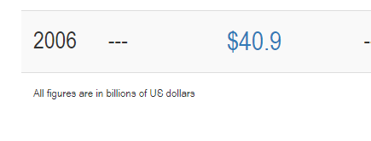
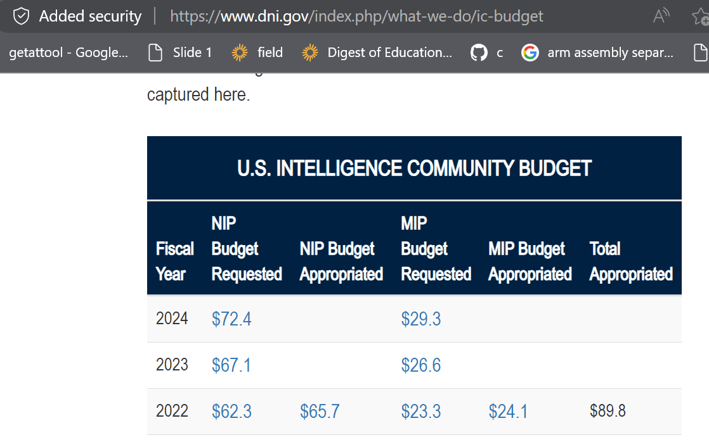


Slide 29
Game: what’s the best way

Slide 30
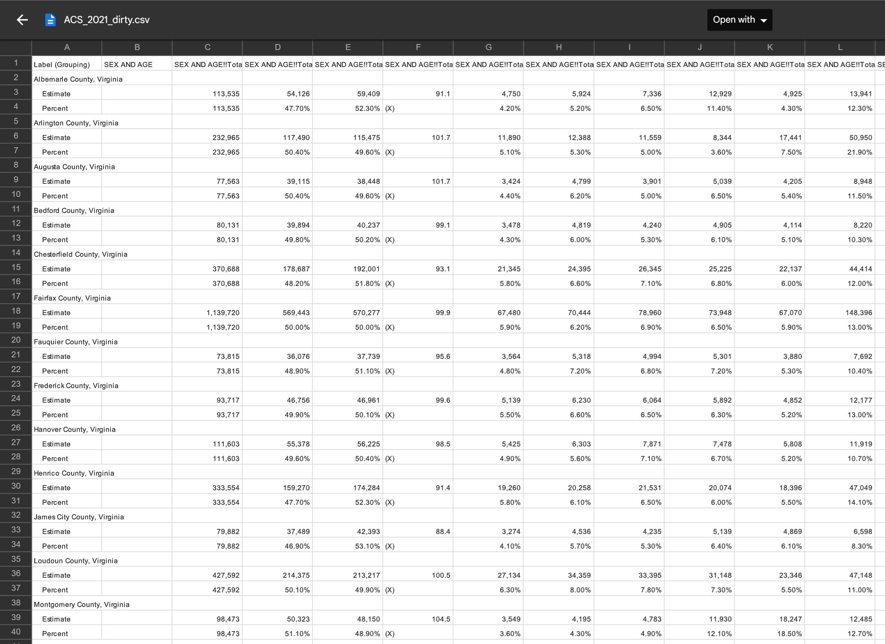
Help a sociologist clean this

Slide 31
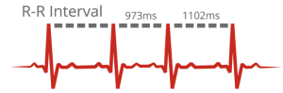
Buy a sensor to measure Heart Rate Variability in a non-medical setting

Slide 32

Get Heart Rate Variability data from this device for research use

Slide 33

Create a web presence for your 88 year-old piano teacher neighbor

Slide 34
systems engineering is information engineering

Slide 35
More & better information is powerful.

Slide 37
You know who else likes information?

Slide 38

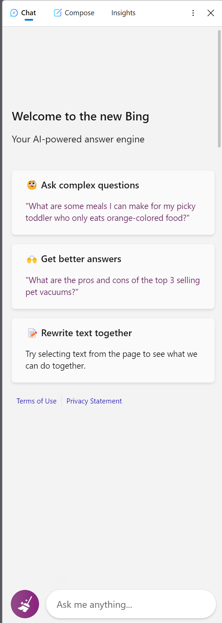

Slide 39
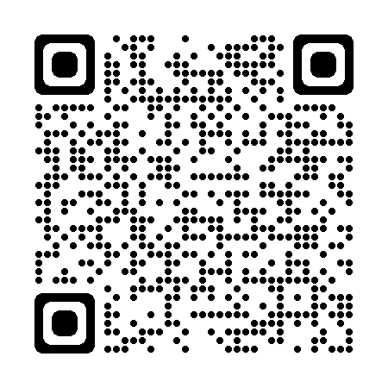



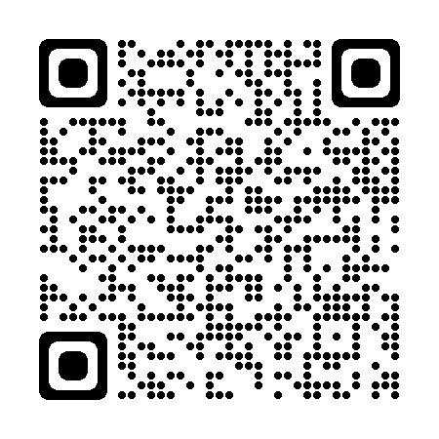
Nicholas Gardella Computer Scientist & Human Systems Engineer
Contact- njg4ne@virginia.edu
Website- https://njg.engineering.virginia.edu
Primary Services- teaching, consulting, research
Secondary Services- software development, tutoring
Free Services- 1-to-1 mentorship, public speaking
hfesuva@gmail.com
https://hfes.atuva.ga/
sriggs@virginia.edu
https://sriggslab.com/

